Slide 1
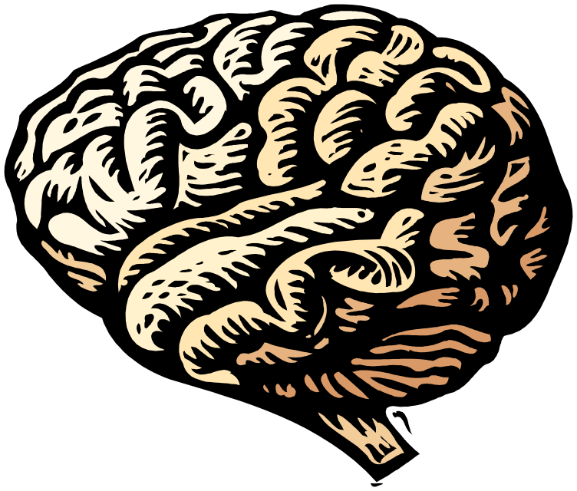
Fundamentals of AI
Intelligence and Computers

Slide 2

What is Intelligence?
Logical Thought
Problem Solving
Decision Making
Learning / Adaptation

Slide 3





Kenneth Craik’s Model:
An intelligent automaton…
Uses a small-scale model of reality
Is capable of performing actions
Has knowledge of effects of actions
Uses inference to make decisions

Slide 4
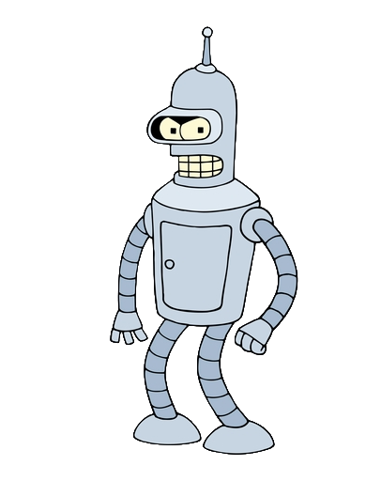
What is Artificial Intelligence?
Beneath that warm, fuzzy exterior beats the cold, mechanical heart of a robot!
Computers are pretty good at…
Mathematical computation
Remembering information
But extremely bad at…
Solving problems
Making decisions
Learning
Through AI, we hope to give machines the ability to reason and to appear more lifelike.

Slide 5


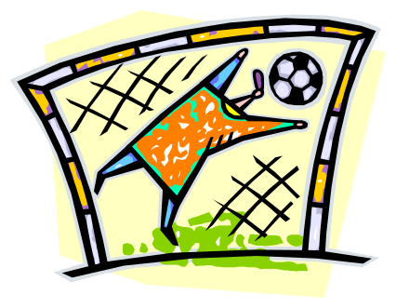
Agents, Agents, Everywhere!
We call an AI program or machine an agent.
Types of agents Behavior
Reflex Reactionary
Goal-based Seeking some goal
Utility-based Seeking utility (“happiness”)

Slide 6
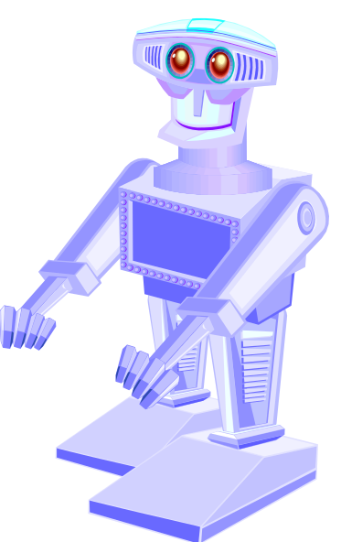
Acquiring Knowledge
Agents have to take in (and filter) information
about the world to acquire knowledge.
Three main ways are:
Cheating
Sensors (view cones, sound radius, etc.)
Communication (and picking roles)
Cheating is good for competitive AI, but can annoy players if discovered. Sensors (possibly with reaction times or probabilities) can be good for “fun” or “realistic” AI.

